Slide 1

FOOD DELIVERY SYSTEM
Welcome to

Slide 2
ONLINE FOOD DELIVERY
Submitted by:
HARSHI AGRAWAL
Section-B
RISHABH KUSHWAHA
Section-C
VANSHIKA JAIN
Section-C
-Department of Information Technology

Slide 3
Abstract
ONLINE FOOD DELIVERY SYSTEM is a website designed primarily for use in the food delivery industry. This system will allow hotels restaurants scope of business by reducing the labor cost involved. The system also allows to quickly and easily manage an online menu which customers can browse and use to place orders with just few clicks. Restaurant employees then use these orders through an easy to navigate graphical interface for efficient processing.

Slide 4
INTRODUCTION
This system presents interactive and up-to-date menu with all available option in an easy to use manner. Customers can choose one or more items to place an order which will land in the cart. Customers can view all the order details in the cart before checking out. At the end there will be a thank you page where the customers must fill the feedback and then the customers gets order confirmation details.

Slide 5
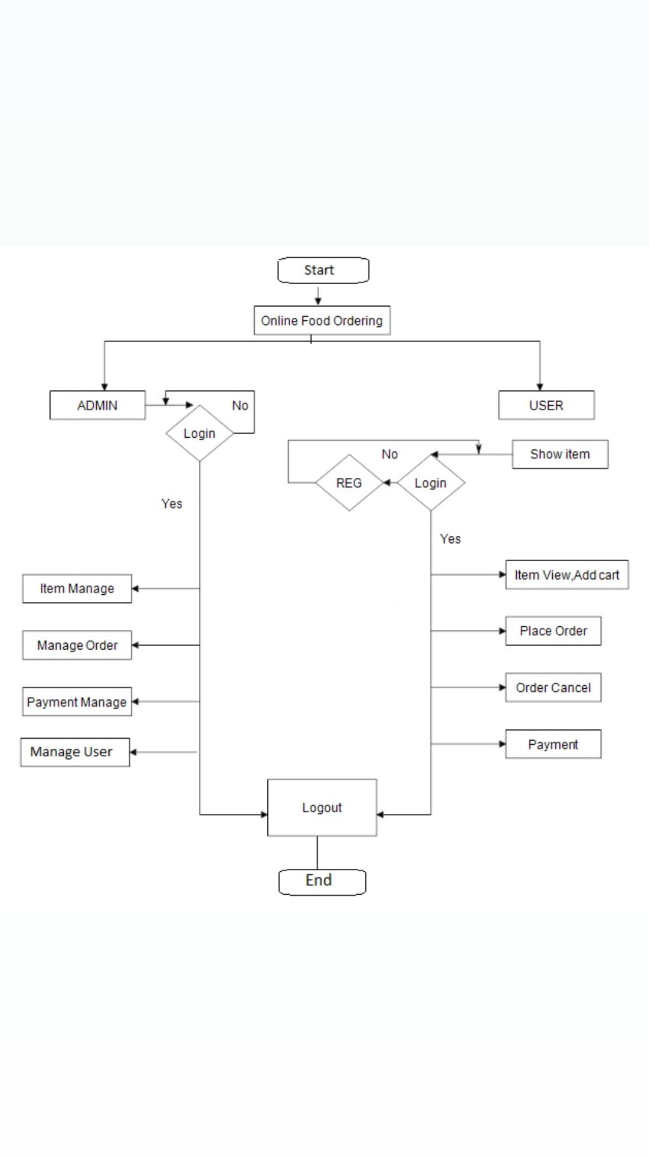
Flow Chart

Slide 6
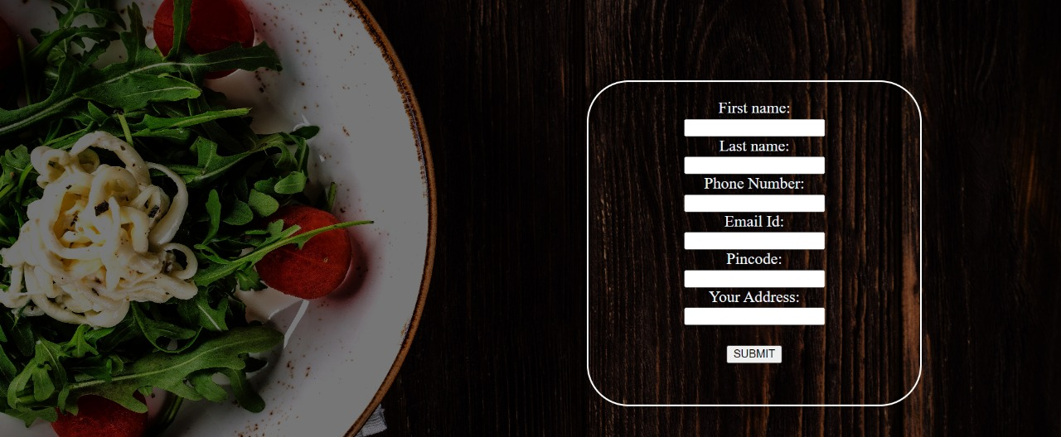
Registration Page
Users can enter their personal details to proceed further by clicking on “SUBMIT” button.

Slide 7
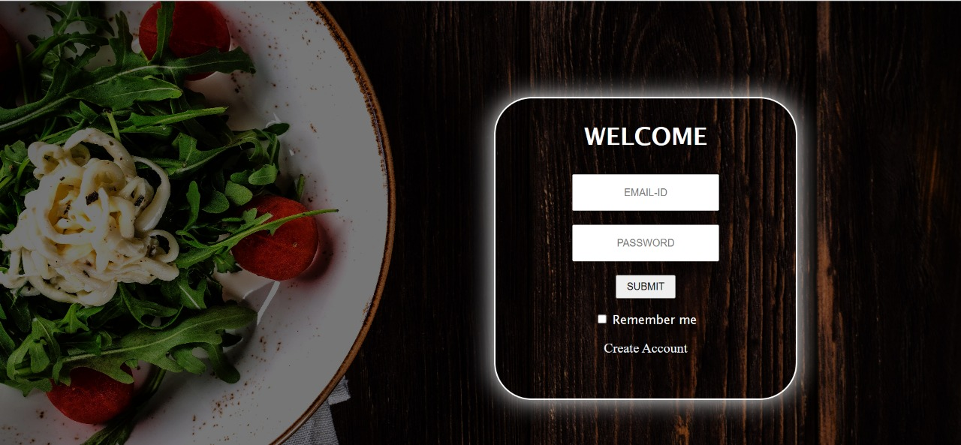
Login page
First of all users can enter their login id and password or if you are a new user you can create your account .

Slide 8
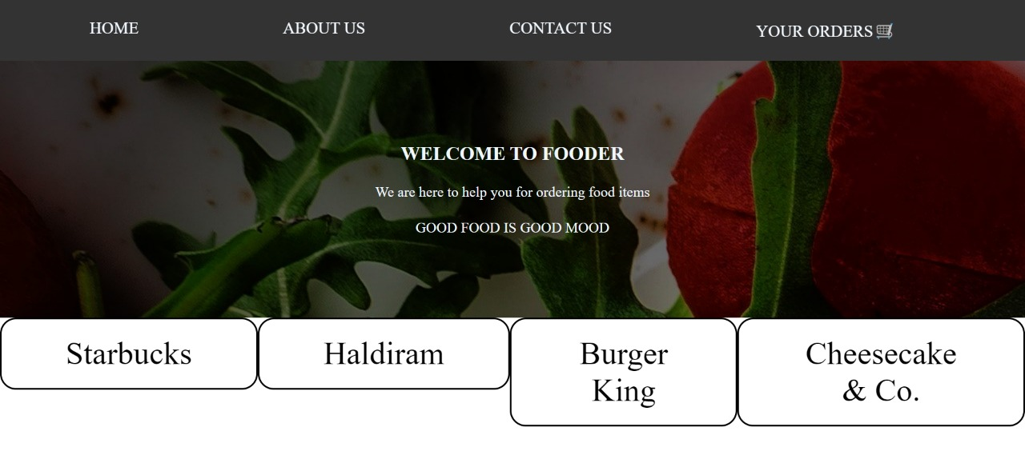
Home Page
After logging in the page a home page will be open .
Here you can select your desired restaurants from which you want to order.

Slide 9
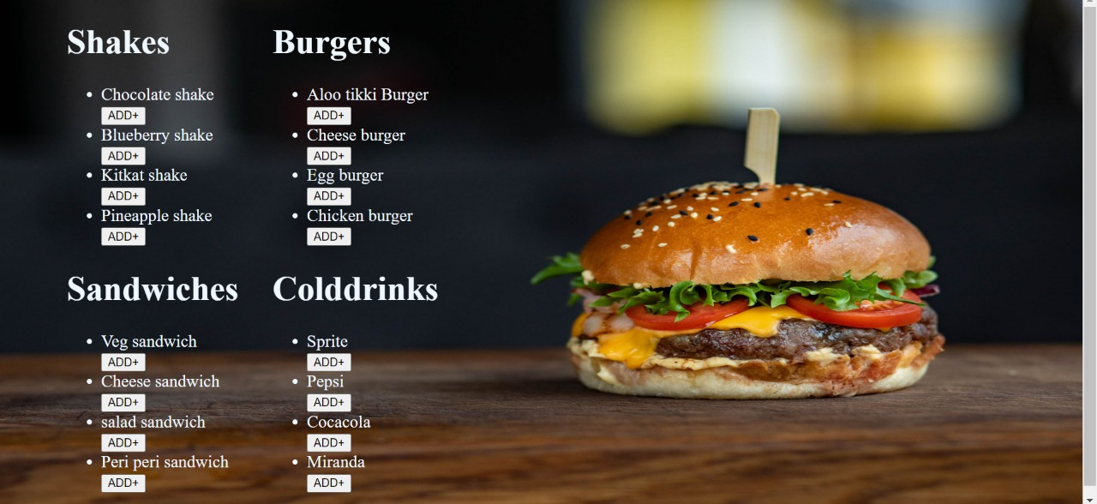
Food Menu
Now users can choose their favourite food from the given menu card and then they can add it to cart by clicking on “ADD+” button.

Slide 10
After adding the food items in your cart. Now your order is placed successfully.

Slide 11
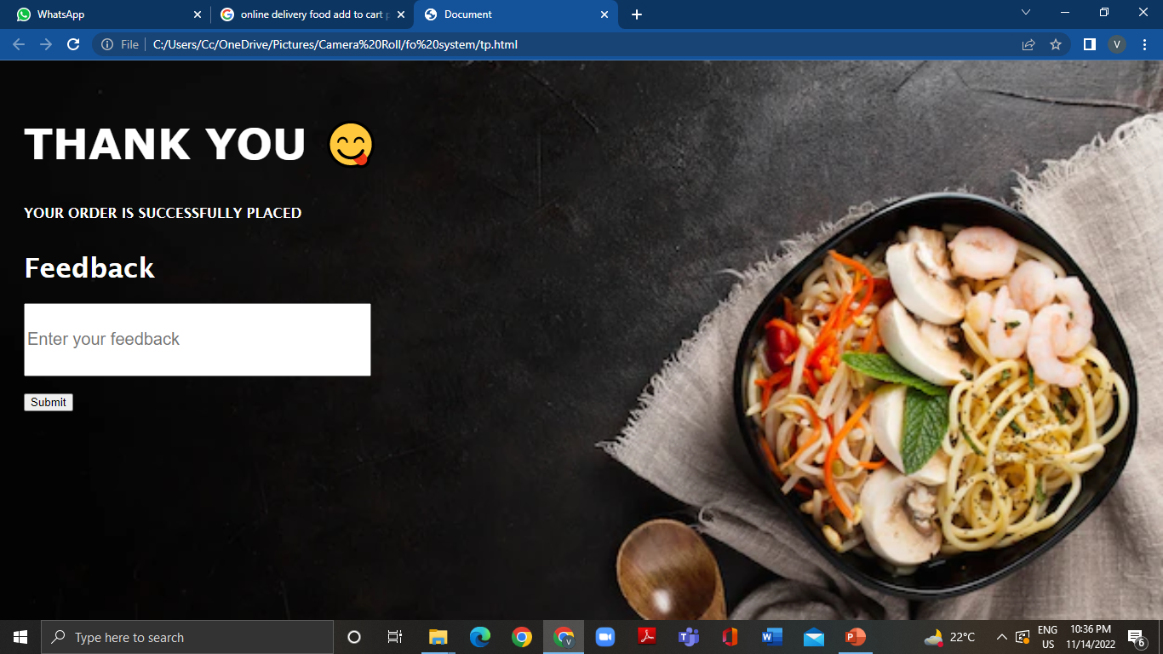
YOUR ORDER HAS BEEN
SUCCESSFULLY PLACED. You can write you feedback .

Slide 12
THANK YOU
We are very grateful to have this opportunity of presenting our project in the INNOTECH.

